Slide 1




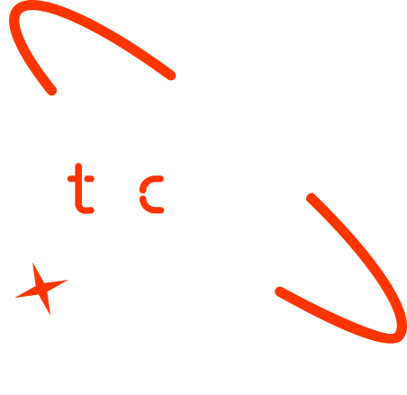

Early Detection of Breast Cancer Using Gene Expression Profiling and Machine Learning Approaches
1.Lames Salih
2.Moaaz Yousif
3.Zongo Thierry
Date: 6-JUN-2025

Slide 2

Outline
Concept note and implementation plan
Background
Objectives
SDG Relation
Data
Data Collection
Exploratory Data Analysis et Feature Engineering
Model
Model Selection and Training
Model Evaluation and Hyperparameter Tuning
Model Refinement and Testing
Results
Evaluation Results
Deployment
Future Work

Slide 3
Concept note and Implementation Plan
Notes:
FTs like precision agriculture, remote sensing & AI-powered forming equipment can help increase agricultural productivity in LDCs. This can improve fiid security & contribute to the achievement of SDG 2 (Zero Hunger).

Slide 4
Background
Problem Statement:
Breast cancer is the most common cancer among women worldwide, with over 2 million new cases annually.
Late diagnosis and limited access to advanced diagnostic tools in low-resource settings lead to poor survival rates.
Solution:
Develop a non-invasive, cost-effective, and scalable early detection system using RNA-Seq data and machine learning.
Leverage gene expression profiling to identify biomarkers for early-stage breast cancer.
Relevance:
Aligns with global health priorities and advances precision medicine.
Provides a framework for equitable access to diagnostic tools.
Notes:
FTs like precision agriculture, remote sensing & AI-powered forming equipment can help increase agricultural productivity in LDCs. This can improve fiid security & contribute to the achievement of SDG 2 (Zero Hunger).

Slide 5
Objectives
Identify Biomarkers:
Use RNA-Seq data to uncover gene expression patterns linked to early-stage breast cancer.
Focus on the most significant genes.
Develop a Predictive Model:
Build a machine learning model for accurate and reliable classification of breast cancer cases.
Achieve >85% accuracy in distinguishing between cancerous and healthy samples.
Enhance Diagnostic Tools:
Provide a framework for early detection, especially in resource-constrained settings.
Complement existing diagnostic methods like mammography and biopsy.
Contribute to Research:
Advance computational biology by offering a scalable methodology for biomarker discovery.
Publish findings to support future research in cancer diagnostics.
Notes:
FTs like precision agriculture, remote sensing & AI-powered forming equipment can help increase agricultural productivity in LDCs. This can improve fiid security & contribute to the achievement of SDG 2 (Zero Hunger).

Slide 6



SDG Relation
SDG 3: Good Health and Well-being
Improve public health by enhancing early cancer detection and reducing mortality rates.
Contribute to the global fight against breast cancer.
SDG 10: Reduced Inequalities
Bridge healthcare gaps by providing accessible diagnostic tools for underserved populations.
Ensure equitable access to advanced diagnostic technologies.
SDG 9: Industry, Innovation, and Infrastructure
Drive innovation in healthcare technology and research infrastructure.
Promote the use of machine learning and genomics in clinical settings.
Notes:
FTs like precision agriculture, remote sensing & AI-powered forming equipment can help increase agricultural productivity in LDCs. This can improve fiid security & contribute to the achievement of SDG 2 (Zero Hunger).

Slide 7
Data
Notes:
FTs like precision agriculture, remote sensing & AI-powered forming equipment can help increase agricultural productivity in LDCs. This can improve fiid security & contribute to the achievement of SDG 2 (Zero Hunger).

Slide 8
Data Collection
RNA-Seq data extracted from GEO.
Dataset includes gene expression counts and clinical metadata.
Notes:
FTs like precision agriculture, remote sensing & AI-powered forming equipment can help increase agricultural productivity in LDCs. This can improve fiid security & contribute to the achievement of SDG 2 (Zero Hunger).

Slide 9
Exploratory Data Analysis and Feature Engineering
Exploratory Data Analysis (EDA):
Identified significant differences in gene expression between cancerous and non-cancerous tissues.
Visualizations:
Heatmaps: Show gene expression patterns across samples.
PCA Plots: Highlight clustering of breast cancer subtypes.
Summary Statistics:
Highly expressed genes associated with tumorigenesis.
Feature Engineering:
SMOTE: Address class imbalance by oversampling the minority class.
StandardScaler: Normalize gene expression values for model training.
Notes:
FTs like precision agriculture, remote sensing & AI-powered forming equipment can help increase agricultural productivity in LDCs. This can improve fiid security & contribute to the achievement of SDG 2 (Zero Hunger).

Slide 10
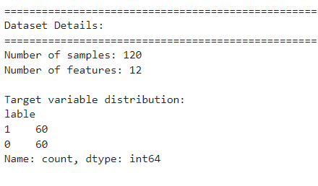
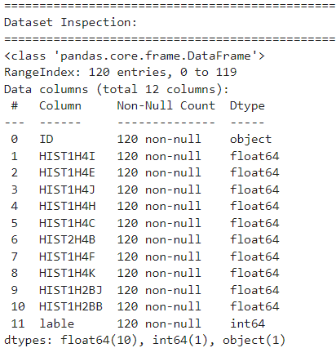
Exploratory Data Analysis
Dataset Inspection:
Dataset Structure:
Number of rows and columns.
Data types of features.
Notes:
FTs like precision agriculture, remote sensing & AI-powered forming equipment can help increase agricultural productivity in LDCs. This can improve fiid security & contribute to the achievement of SDG 2 (Zero Hunger).

Slide 11
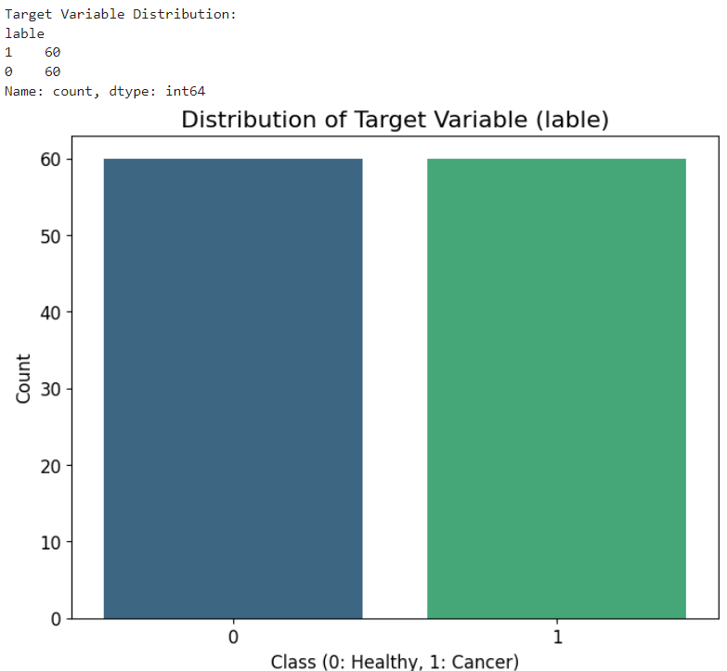
Exploratory Data Analysis
Bar chart showing the distribution of the target variable.
Notes:
FTs like precision agriculture, remote sensing & AI-powered forming equipment can help increase agricultural productivity in LDCs. This can improve fiid security & contribute to the achievement of SDG 2 (Zero Hunger).

Slide 12
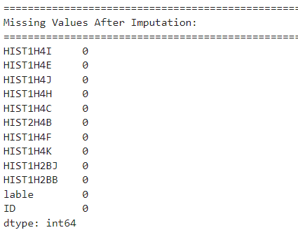
Exploratory Data Analysis
Handling Missing Values
Imputation Strategy:
Missing values are imputed using the mean strategy.
Outcome:
Dataset is complete and ready for analysis
Notes:
FTs like precision agriculture, remote sensing & AI-powered forming equipment can help increase agricultural productivity in LDCs. This can improve fiid security & contribute to the achievement of SDG 2 (Zero Hunger).

Slide 13
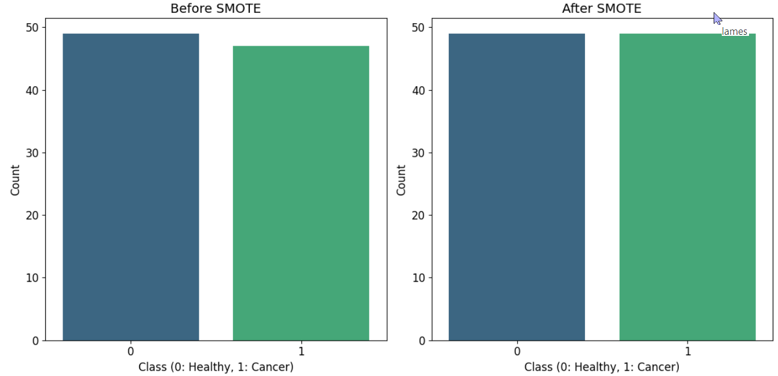
Feature Engineering
Handling Class Imbalance with SMOTE:
Problem: The dataset is imbalanced (e.g., more healthy samples than cancerous ones).
Solution: Apply SMOTE to oversample the minority class.
Outcome: Balanced dataset for better model performance.
Notes:
FTs like precision agriculture, remote sensing & AI-powered forming equipment can help increase agricultural productivity in LDCs. This can improve fiid security & contribute to the achievement of SDG 2 (Zero Hunger).

Slide 14
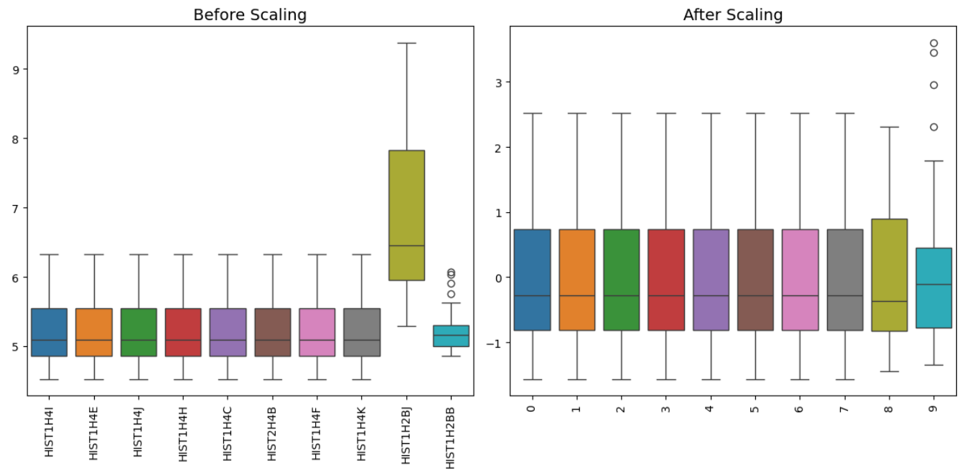
Feature Engineering
Feature Scaling
What is done?
Features are scaled using StandardScaler (mean = 0, standard deviation = 1).
Purpose:
Ensure all features are on the same scale for better model performance.
Notes:
FTs like precision agriculture, remote sensing & AI-powered forming equipment can help increase agricultural productivity in LDCs. This can improve fiid security & contribute to the achievement of SDG 2 (Zero Hunger).

Slide 15
Exploratory Data Analysis and Feature Engineering Visualizations
Boxplot of Raw Data: Identify outliers and understand the spread of raw gene expression values.
Boxplot of Normalized Data: Compare the spread of data before and after normalization.
Histogram of Raw Data: Understand the distribution and skewness of raw data.
Histogram of Normalized Data: Compare the distribution of data before and after normalization.
Correlation Heatmap: Identify highly correlated features and reduce multicollinearity.
PCA for Clustering Visualization: Check if the data forms distinct clusters for cancerous and healthy samples.
Notes:
FTs like precision agriculture, remote sensing & AI-powered forming equipment can help increase agricultural productivity in LDCs. This can improve fiid security & contribute to the achievement of SDG 2 (Zero Hunger).

Slide 16
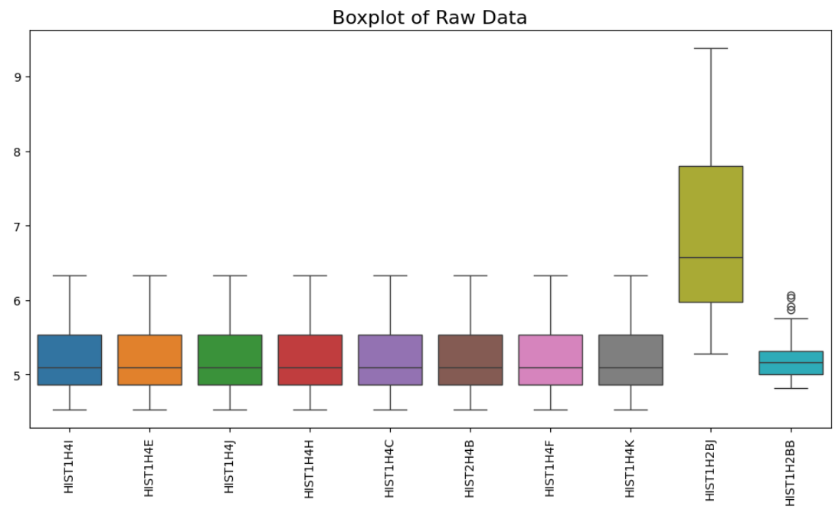
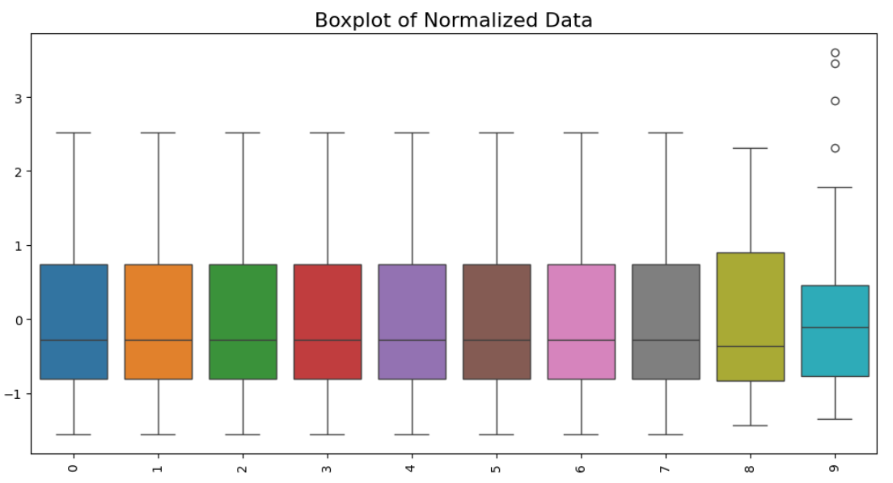
Exploratory Data Analysis and Feature Engineering Visualizations
Notes:
FTs like precision agriculture, remote sensing & AI-powered forming equipment can help increase agricultural productivity in LDCs. This can improve fiid security & contribute to the achievement of SDG 2 (Zero Hunger).

Slide 17
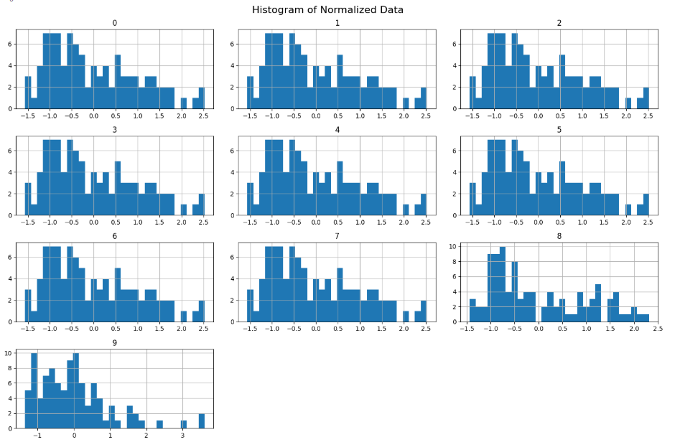
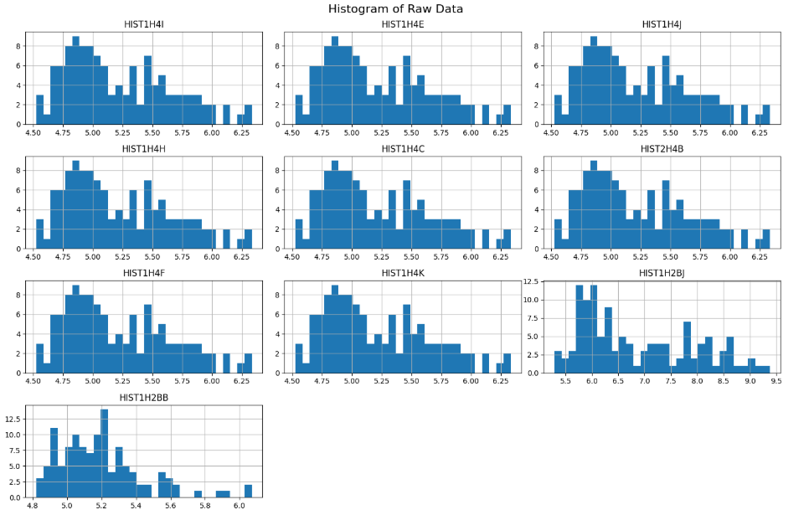
Exploratory Data Analysis and Feature Engineering Visualizations
Notes:
FTs like precision agriculture, remote sensing & AI-powered forming equipment can help increase agricultural productivity in LDCs. This can improve fiid security & contribute to the achievement of SDG 2 (Zero Hunger).

Slide 18
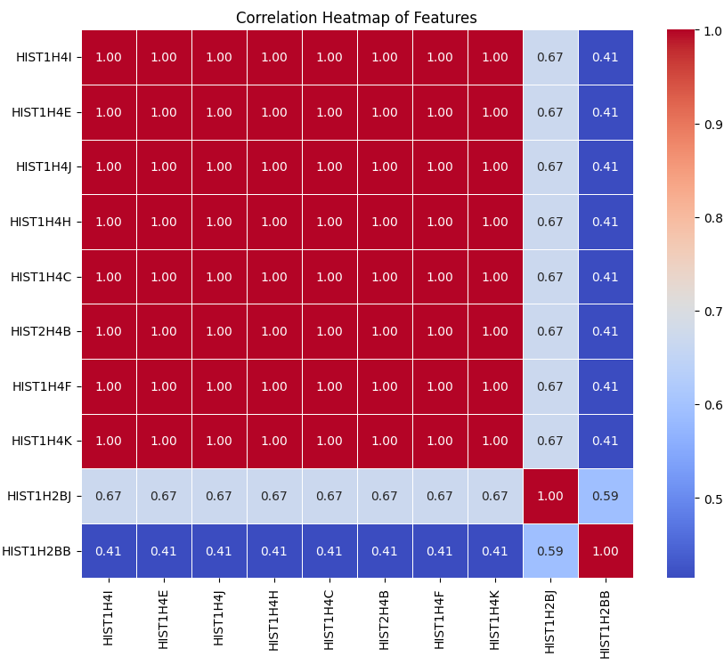
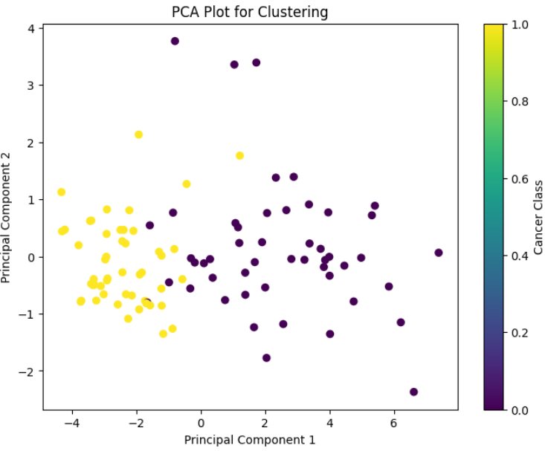
Exploratory Data Analysis and Feature Engineering
Notes:
FTs like precision agriculture, remote sensing & AI-powered forming equipment can help increase agricultural productivity in LDCs. This can improve fiid security & contribute to the achievement of SDG 2 (Zero Hunger).

Slide 19
Model
Notes:
FTs like precision agriculture, remote sensing & AI-powered forming equipment can help increase agricultural productivity in LDCs. This can improve fiid security & contribute to the achievement of SDG 2 (Zero Hunger).

Slide 20
Model Selection and Training
Algorithms Used:
Random Forest (RF): Ensemble method for feature selection and classification.
Gradient Boosting (GB): Boosting method for improved accuracy.
Training Process:
Data Splitting: 80% training, 20% testing.
Class Imbalance Handling: SMOTE for oversampling the minority class.
Feature Scaling: StandardScaler for normalization.
Purpose:
Train models to classify breast cancer cases accurately.
Notes:
FTs like precision agriculture, remote sensing & AI-powered forming equipment can help increase agricultural productivity in LDCs. This can improve fiid security & contribute to the achievement of SDG 2 (Zero Hunger).

Slide 21
Model Evaluation and Hyperparameter Tuning
Evaluation Metrics:
Accuracy, Precision, Recall, F1-Score, ROC-AUC.
Hyperparameter Tuning for Random Forest:
GridSearchCV: Optimized parameters include n_estimators, max_depth, min_samples_split, and min_samples_leaf.
Outcome:
Improved model performance and reduced overfitting.
Notes:
FTs like precision agriculture, remote sensing & AI-powered forming equipment can help increase agricultural productivity in LDCs. This can improve fiid security & contribute to the achievement of SDG 2 (Zero Hunger).

Slide 22
Model Refinement and Testing
Refinement Techniques:
Cross-Validation: 5-fold cross-validation to ensure robustness.
Learning Curve: Analyze model performance with increasing training data.
Feature Importance: Identify key biomarkers for breast cancer classification.
Testing Results:
Random Forest Accuracy: 96%.
Confusion Matrix: Visualize true vs. predicted classes.
ROC Curve: Evaluate model performance at different thresholds.
Outcome:
Reliable and interpretable model for breast cancer detection.
Notes:
FTs like precision agriculture, remote sensing & AI-powered forming equipment can help increase agricultural productivity in LDCs. This can improve fiid security & contribute to the achievement of SDG 2 (Zero Hunger).

Slide 23
Results
Notes:
FTs like precision agriculture, remote sensing & AI-powered forming equipment can help increase agricultural productivity in LDCs. This can improve fiid security & contribute to the achievement of SDG 2 (Zero Hunger).

Slide 24
Evaluation Results
Model Performance:
Both Random Forest and Gradient Boosting achieved 96% accuracy on the test set.
Precision, Recall, and F1-Score:
Class 0 (Healthy): Precision = 1.00, Recall = 0.91, F1-Score = 0.95.
Class 1 (Cancer): Precision = 0.93, Recall = 1.00, F1-Score = 0.96.
Balanced performance across both classes (Macro Avg: 0.96).
Confusion Matrix:
Random Forest: 10 TP, 10 TN, 1 FN, 3 FP.
Gradient Boosting: 13 TP, 10 TN, 1 FN, 0 FP.
ROC Curve and AUC:
Both models have high AUC values (close to 1), indicating excellent discrimination.
Notes:
FTs like precision agriculture, remote sensing & AI-powered forming equipment can help increase agricultural productivity in LDCs. This can improve fiid security & contribute to the achievement of SDG 2 (Zero Hunger).

Slide 25
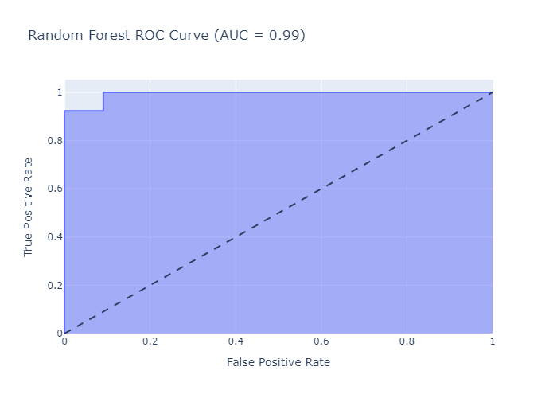
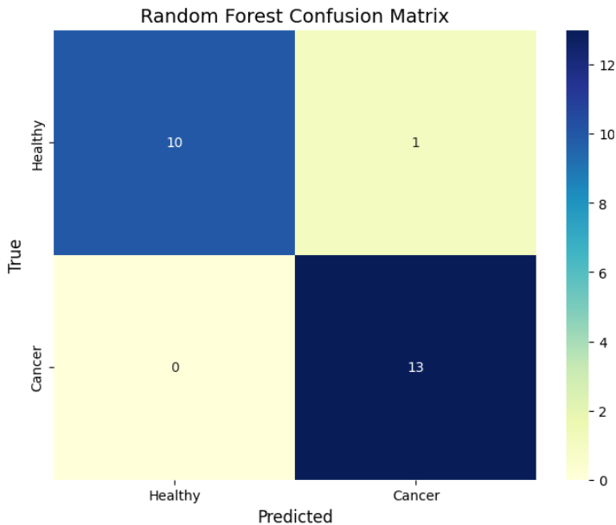
Evaluation Results
Notes:
FTs like precision agriculture, remote sensing & AI-powered forming equipment can help increase agricultural productivity in LDCs. This can improve fiid security & contribute to the achievement of SDG 2 (Zero Hunger).

Slide 26
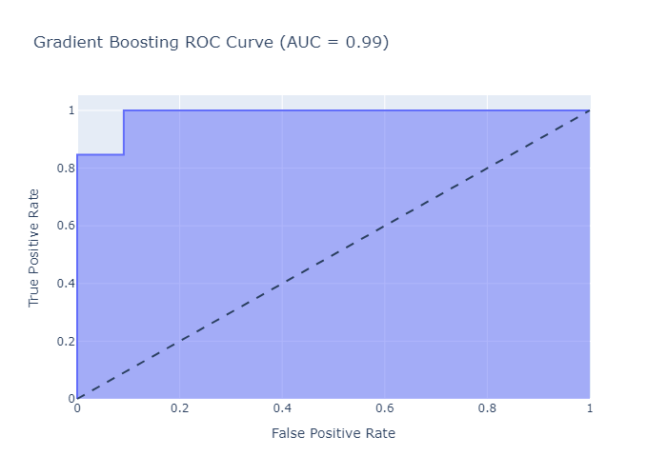
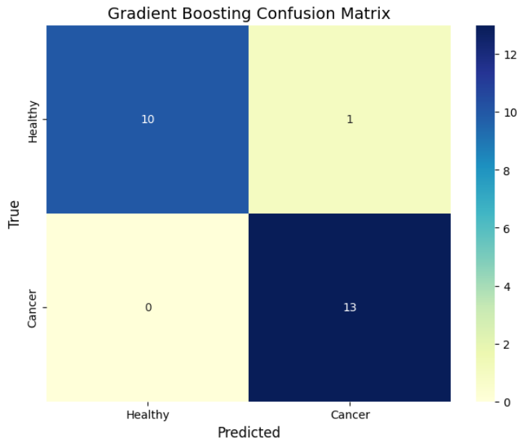
Evaluation Results
Notes:
FTs like precision agriculture, remote sensing & AI-powered forming equipment can help increase agricultural productivity in LDCs. This can improve fiid security & contribute to the achievement of SDG 2 (Zero Hunger).

Slide 27
Evaluation Refinement Results
Computational Efficiency
Random Forest:
Parallelization: Random Forest trains multiple decision trees independently, making it highly parallelizable. This reduces training time significantly, especially for large datasets or when using GridSearchCV for hyperparameter tuning.
Ease of Tuning: The hyperparameters of Random Forest are relatively straightforward to tune, and the model is less sensitive to hyperparameter choices compared to Gradient Boosting.
Gradient Boosting:
Sequential Training: Gradient Boosting builds trees sequentially, where each tree corrects the errors of the previous one. This makes training slower and harder to parallelize.
Hyperparameter Sensitivity: Gradient Boosting is more sensitive to hyperparameters and tuning them requires more computational resources and time.
Notes:
FTs like precision agriculture, remote sensing & AI-powered forming equipment can help increase agricultural productivity in LDCs. This can improve fiid security & contribute to the achievement of SDG 2 (Zero Hunger).

Slide 28
Evaluation Refinement Results
Why Random Forest?
The refinement process involves GridSearchCV, which evaluates many hyperparameter combinations. Random Forest's parallelizable nature makes this process faster and more efficient.
Results After Refinement:
Testing Accuracy: 95.83%
Cross-Validation Accuracy: 92.50%
Precision, Recall, F1-Score: All > 0.90 for both classes.
Low Overfitting: Accuracy gap of 1.96%.
Notes:
FTs like precision agriculture, remote sensing & AI-powered forming equipment can help increase agricultural productivity in LDCs. This can improve fiid security & contribute to the achievement of SDG 2 (Zero Hunger).

Slide 29
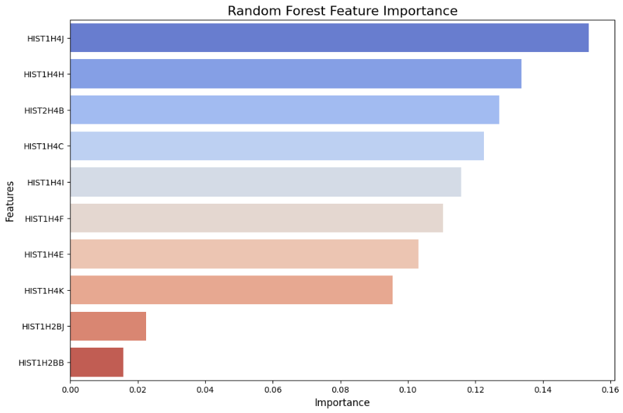
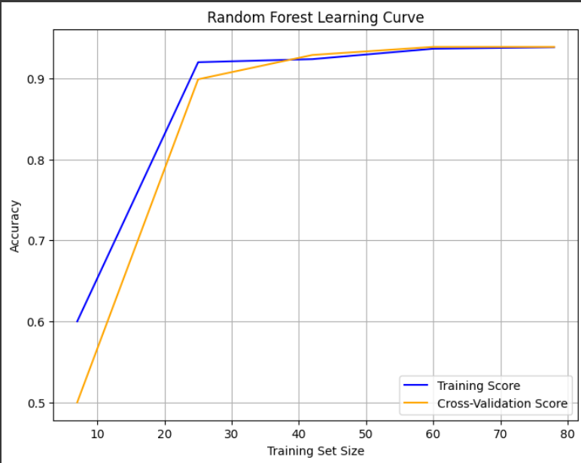
Evaluation Refinement Results
Notes:
FTs like precision agriculture, remote sensing & AI-powered forming equipment can help increase agricultural productivity in LDCs. This can improve fiid security & contribute to the achievement of SDG 2 (Zero Hunger).

Slide 30
Deployment
Front-end model Deployment Overview:
Front-end build using HTML CSS and JavaScript for more adaptability.
Back-end development overview:
The back-end of our plateforme is implemented by:
Ajax and PHP for the prediction result displaying and the inputs controlling.
API: we used FlaskApi for the back-end connection.
Notes:
FTs like precision agriculture, remote sensing & AI-powered forming equipment can help increase agricultural productivity in LDCs. This can improve fiid security & contribute to the achievement of SDG 2 (Zero Hunger).

Slide 31
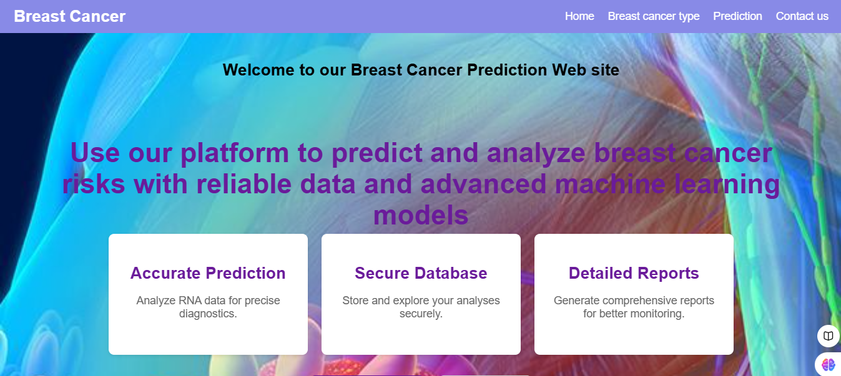
Deployment
Notes:
FTs like precision agriculture, remote sensing & AI-powered forming equipment can help increase agricultural productivity in LDCs. This can improve fiid security & contribute to the achievement of SDG 2 (Zero Hunger).

Slide 32
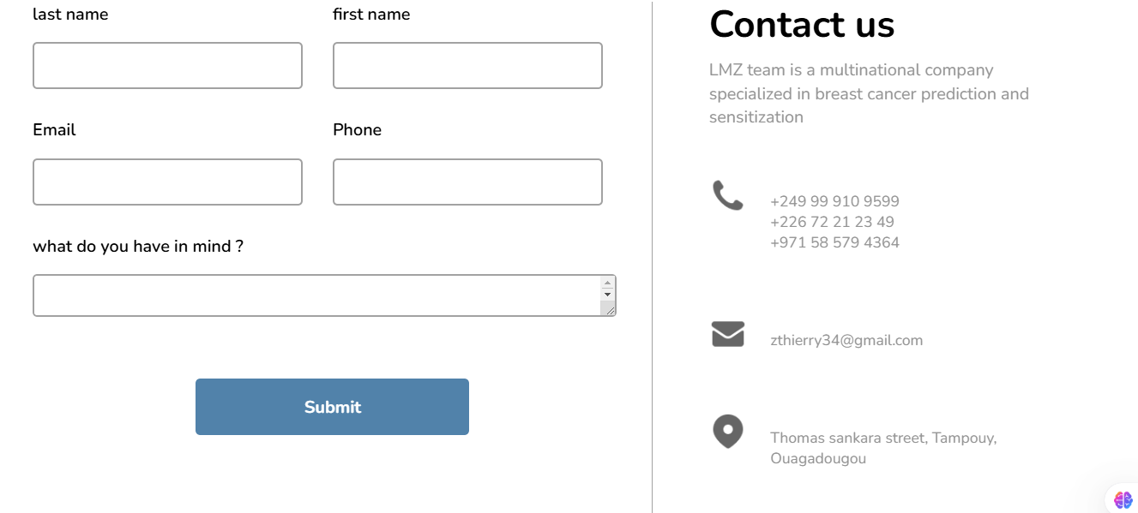
Deployment
Notes:
FTs like precision agriculture, remote sensing & AI-powered forming equipment can help increase agricultural productivity in LDCs. This can improve fiid security & contribute to the achievement of SDG 2 (Zero Hunger).

Slide 33
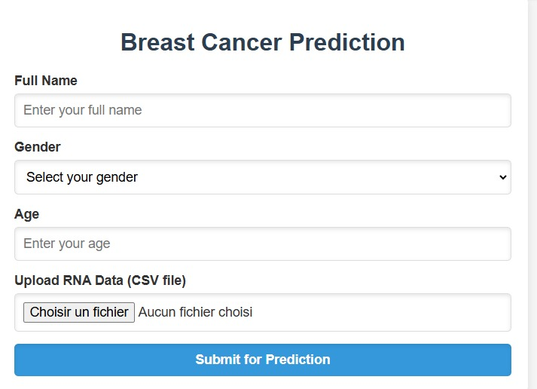
Deployment
Notes:
FTs like precision agriculture, remote sensing & AI-powered forming equipment can help increase agricultural productivity in LDCs. This can improve fiid security & contribute to the achievement of SDG 2 (Zero Hunger).

Slide 34
Future Work
Expand Dataset:
Include more diverse RNA-Seq data for improved generalizability.
Enhance Interpretability:
Use SHAP or LIME for better model transparency.
Explore Deep Learning:
Investigate neural networks for potentially higher accuracy.
Publishing research papers.
Integration with Healthcare Systems:
Deploy the model in clinical settings for real-world impact.
Notes:
FTs like precision agriculture, remote sensing & AI-powered forming equipment can help increase agricultural productivity in LDCs. This can improve fiid security & contribute to the achievement of SDG 2 (Zero Hunger).

Slide 35
References
Key Papers:
1. Parker, J. S., et al. (2009). Supervised risk predictor of breast cancer based on intrinsic subtypes. Journal of Clinical Oncology, 27(8), 1160-1167.
2. Sørlie, T., et al. (2001). Gene expression patterns of breast carcinomas distinguish tumor subclasses with clinical implications. Proceedings of the National Academy of Sciences, 98(19), 10869-10874.
3. Sahu, A., Qazi, S., Raza, K., Singh, A., Verma, S. (2022). Machine Learning-Based Approach for Early Diagnosis of Breast Cancer Using Biomarkers and Gene Expression Profiles. In: Raza, K. (eds) Computational Intelligence in Oncology. Studies in Computational Intelligence, vol 1016. Springer, Singapore. https://doi.org/10.1007/978-981-16-9221-5_17
Notes:
FTs like precision agriculture, remote sensing & AI-powered forming equipment can help increase agricultural productivity in LDCs. This can improve fiid security & contribute to the achievement of SDG 2 (Zero Hunger).

Slide 36
References
4. R. Al Mamlook, S. Shresth, T. Gharaibeh, A. S. Almuflih, W. Al-Mawee and H. Bzizi, "Machine Learning Approaches for Early Diagnosis of Breast Cancer: A Comparative Study of Performance Evaluation," 2023 IEEE International Conference on Electro Information Technology (eIT), Romeoville, IL, USA, 2023, pp. 271-274, doi: 10.1109/eIT57321.2023.10187257.
Data Source:
GEO Database (GSE203024).
Notes:
FTs like precision agriculture, remote sensing & AI-powered forming equipment can help increase agricultural productivity in LDCs. This can improve fiid security & contribute to the achievement of SDG 2 (Zero Hunger).

Slide 37


Thank you!

